Slide 1
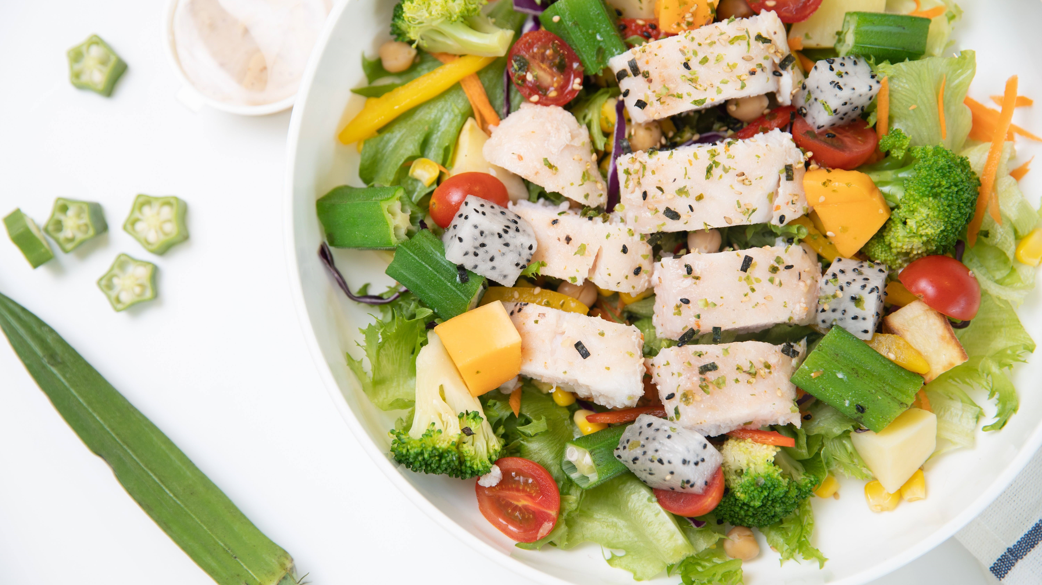
Just be yourself
——the advertising campaign for LF restaurants
芦珺雯 石子莹 孙子淇 刘忆茹 王凤

Slide 2
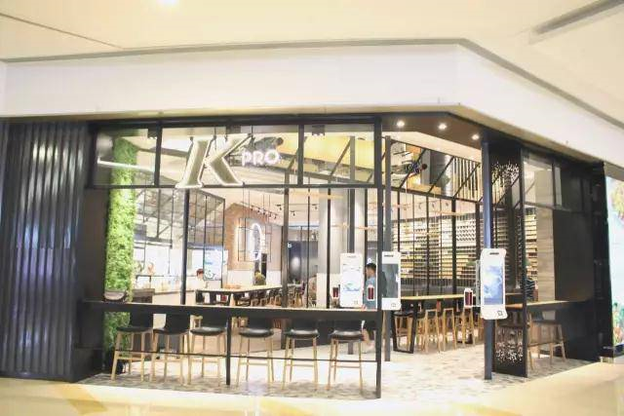

status of industry
Nowadays, people attach great importance to healthy diet,More and more companies are entering the industry
About us

Slide 3
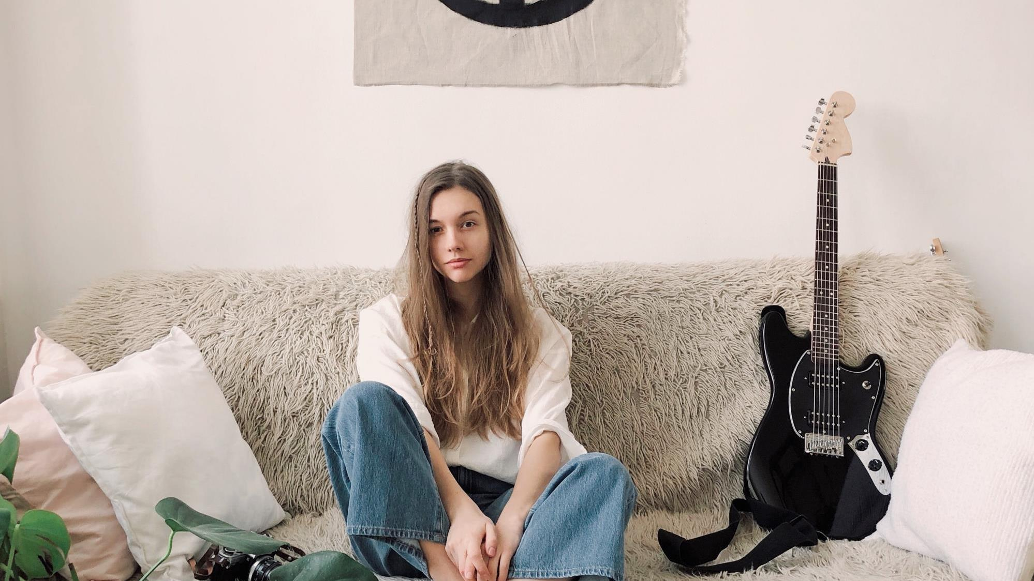
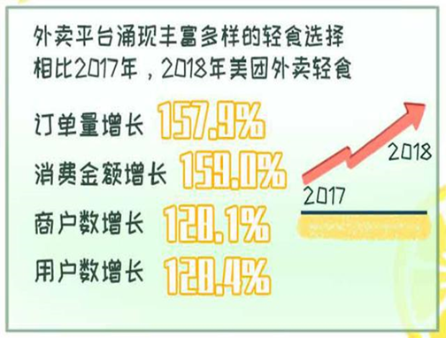
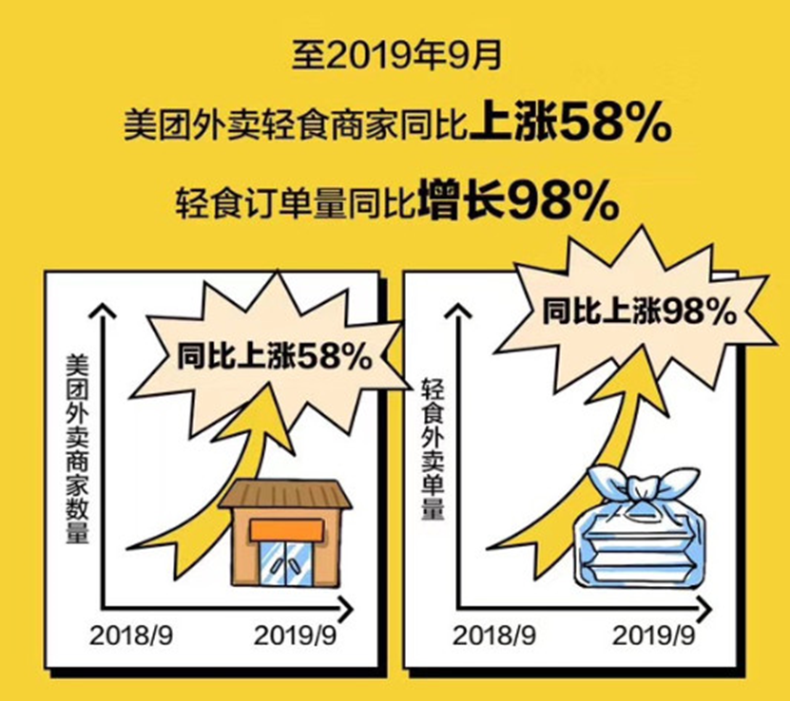
Company
prospect analysis
Promising progress:
1. The number of the middle class, mainly composed of young people, is increasing
2. The order and costing is increasing sharply.
……
Difficulties:
1. The appetites of consumers are different.
2. Restaurants are confronted to the dilemma with single food recipe and unattractive taste.
……
This is an industry full of challenges and opportunities.

Slide 4


product
analysis
convenience
health
individual
reasonable price

Slide 5

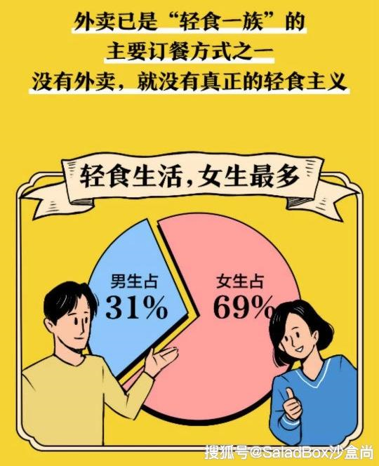
Consumer
1.More female consumers
2.More consumers are born in the 1980s,1990s and 2000s
reason
Why choose a vegetarian restaurant?
health weight loss sharing fitness

Slide 6


Our Target Audience
· The post-80s, post 90s and post 00s
· Health-conscious, body-building and life-sharing group
· Women with consuming ability and high education

Slide 7

Advertising
concept

Slide 8


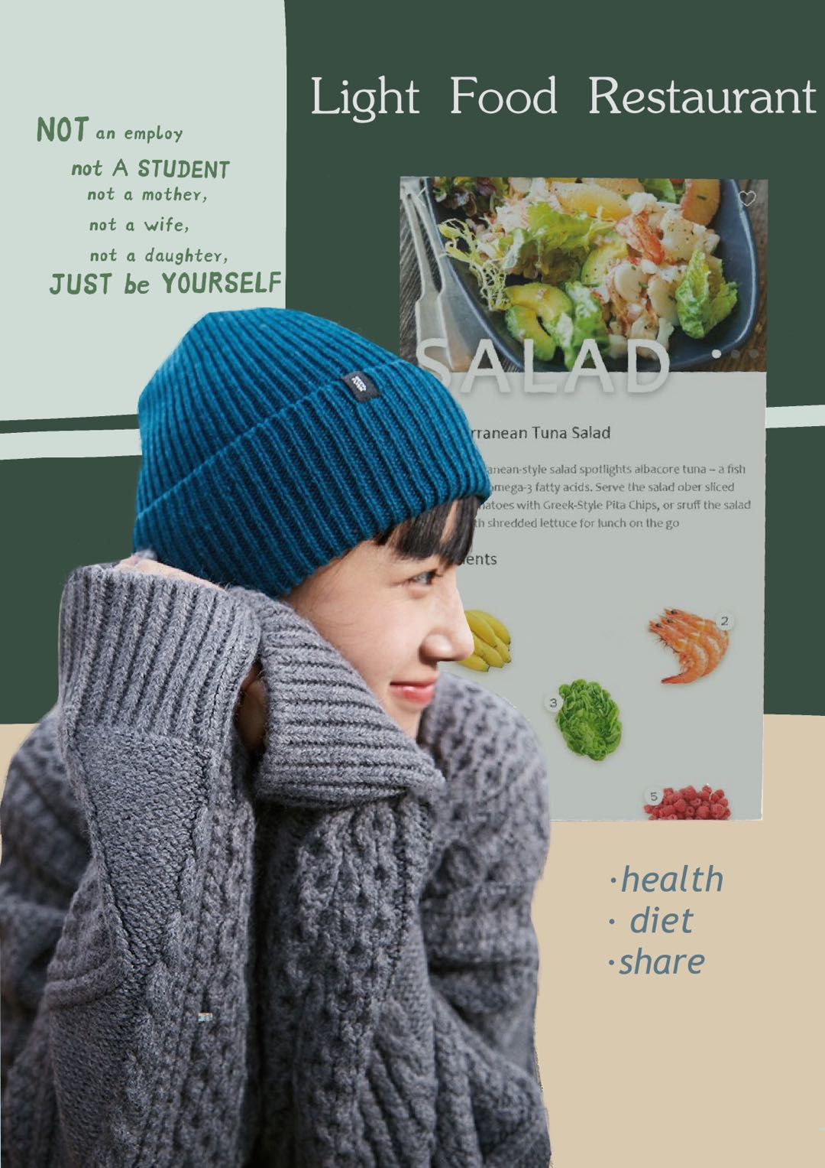

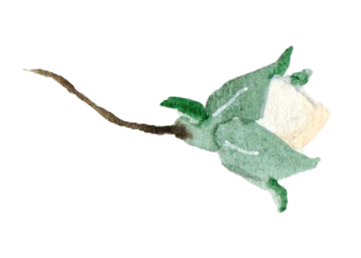
poster we designed
Our USP
Full response to women’s spiritual demand on freedom, independence and internal satisfaction.
Our slogan :
“Not an employee ,
not a student,
not a mother,
not a wife,
not a daughter,
just be yourself.”

Slide 9

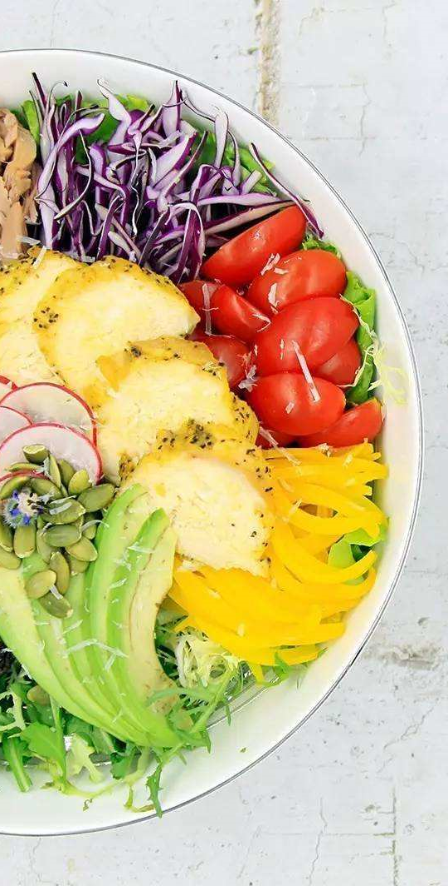


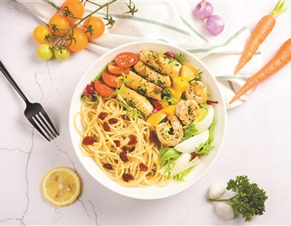
health well-balanced diet
weight loss bodybuilding
Others

Slide 10






Study
Employment
World of work
Pressure on young women
Marriage
Family
Child-bearing

Slide 11

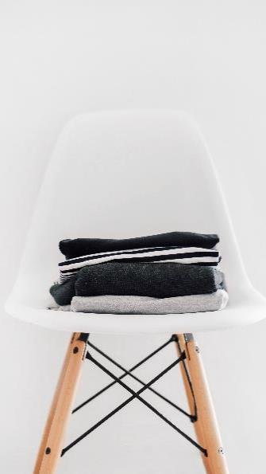
Build the third space
In the 1970s, Ray Oldenburg, an American sociologist, put forward the concept of "third space" from the perspective of urban and social research.
·the first space ——the place where we lived as
·the second space ——the place where we spent a lot of time working
·the third space —— an informal public gathering place outside the living and working places. The concept of "third space" highlighted the social role of the venue, such as cafes, teahouses, bars, community centers, etc

Slide 12


Hierarchical theory of needs
self -actualization need
esteem need
belongingness and love need
physiological need
safety need

Slide 13






Online media
Media
Elevator advertisement

Slide 14




Thanks for your support for environment protection.
SHARING MENU
BLIND BOX
a variety of set menus with good nutrient and good taste
,
a thank-you card and a vegetable-shaped plastic toy
COOPERATION
“one-yuan donation” activity with local environmental protection organizations
Offline promotion

Slide 15

Thanks

